Slide 1



Turning sequence data into information
Noelle Noyes

Slide 2
How to use bioinformatics to turn the sequence data into quantitative data

Slide 3
In most scientific studies, the generated data need to be processed into a quantitative format in order to perform statistics and generate information.
In metagenomic studies, this is also the case. The “special” thing about metagenomic data is that turning it into quantitative data is a major technical challenge.

Slide 4
We overcome this challenge using bioinformatics

Slide 5
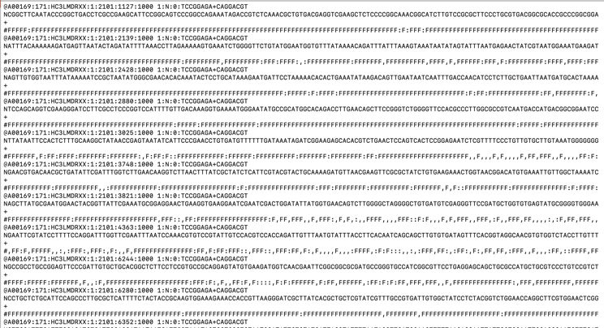
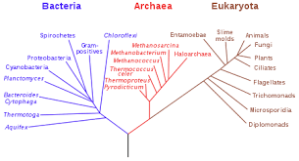
The goal:

Slide 6
What data do we need in order to quantify the microbiome or resistome?
A list of microbes/genes in each sample
A count of each microbe/gene in each sample

Slide 7
How do we turn the sequence data into a list and a count of microbes/genes?
?
A list of microbes/genes in each sample
A count of each microbe/gene in each sample

Slide 8

How do we turn the sequence data into a list and a count of microbes/genes?
(And how many Waldos are there?)

Slide 9

First, we have to know what we’re looking for

Slide 10

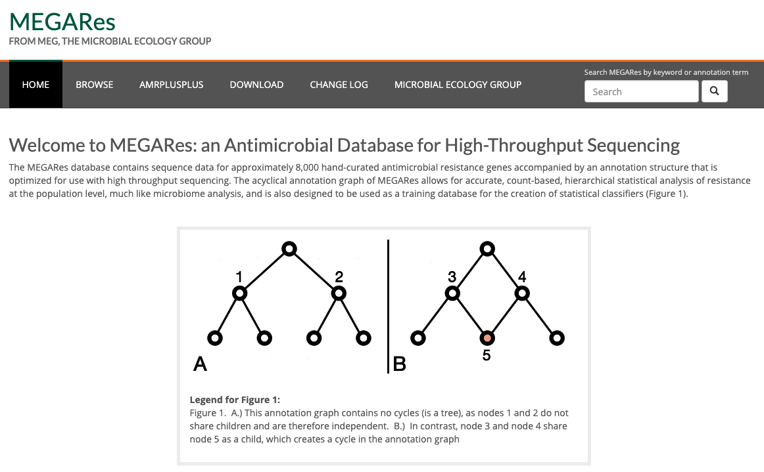
This involves some type of matching to a reference database

Slide 11
The reference database contains the sequences you want to find in the generated sequence data
>Noelle
ATTTGCATTAAAGCGTTTAGCTAGCTA
>Paul
AATTGCATTAAAGCGTTTAGCTACCTA
>Enrique
TTTGCATTACAGCGTATAGCTAGCTC
>Waldo
CTCGTAATTACAGCGTATAGCTAGCGG

Slide 12
Does our sequence data contain Waldo?
To figure that out, we have to search for Waldo’s sequence within the generated sequence data…
This boils down to a fancy matching process

Slide 13
Anatomy of a fastq (seqeuence data) file…

Slide 14
The bioinformatic process involves searching *every* sequence read for *every* reference of interest
>Noelle
ATTTGCATTAAAGCGTTTAGCTAGCTA
>Paul
AATTGCATTAAAGCGTTTAGCTACCTA
>Enrique
TTTGCATTACAGCGTATAGCTAGCTC
>Waldo
CTCGTAATTACAGCGTATAGCTAGCGG

Slide 15
In the end, you generate a count of the number of times each reference sequence was “seen” in the sequence data for each sample
Sample
A
B
C
D
>Noelle
ATTTGCATTAAAGCGTTTAGCTAGCTA
>Paul
AATTGCATTAAAGCGTTTAGCTACCTA
>Enrique
TTTGCATTACAGCGTATAGCTAGCTC
>Waldo
CTCGTAATTACAGCGTATAGCTAGCGG
0
5
50
1
10
1
60
0
10
90
40
0
10
75
55
0

Slide 16
This is the count matrix, and it contains all of the quantitative data that we need to characterize the microbial community
Sample
A
B
C
D
>Noelle
ATTTGCATTAAAGCGTTTAGCTAGCTA
>Paul
AATTGCATTAAAGCGTTTAGCTACCTA
>Enrique
TTTGCATTACAGCGTATAGCTAGCTC
>Waldo
CTCGTAATTACAGCGTATAGCTAGCGG
0
5
50
1
10
1
60
0
10
90
40
0
10
75
55
0

Slide 17
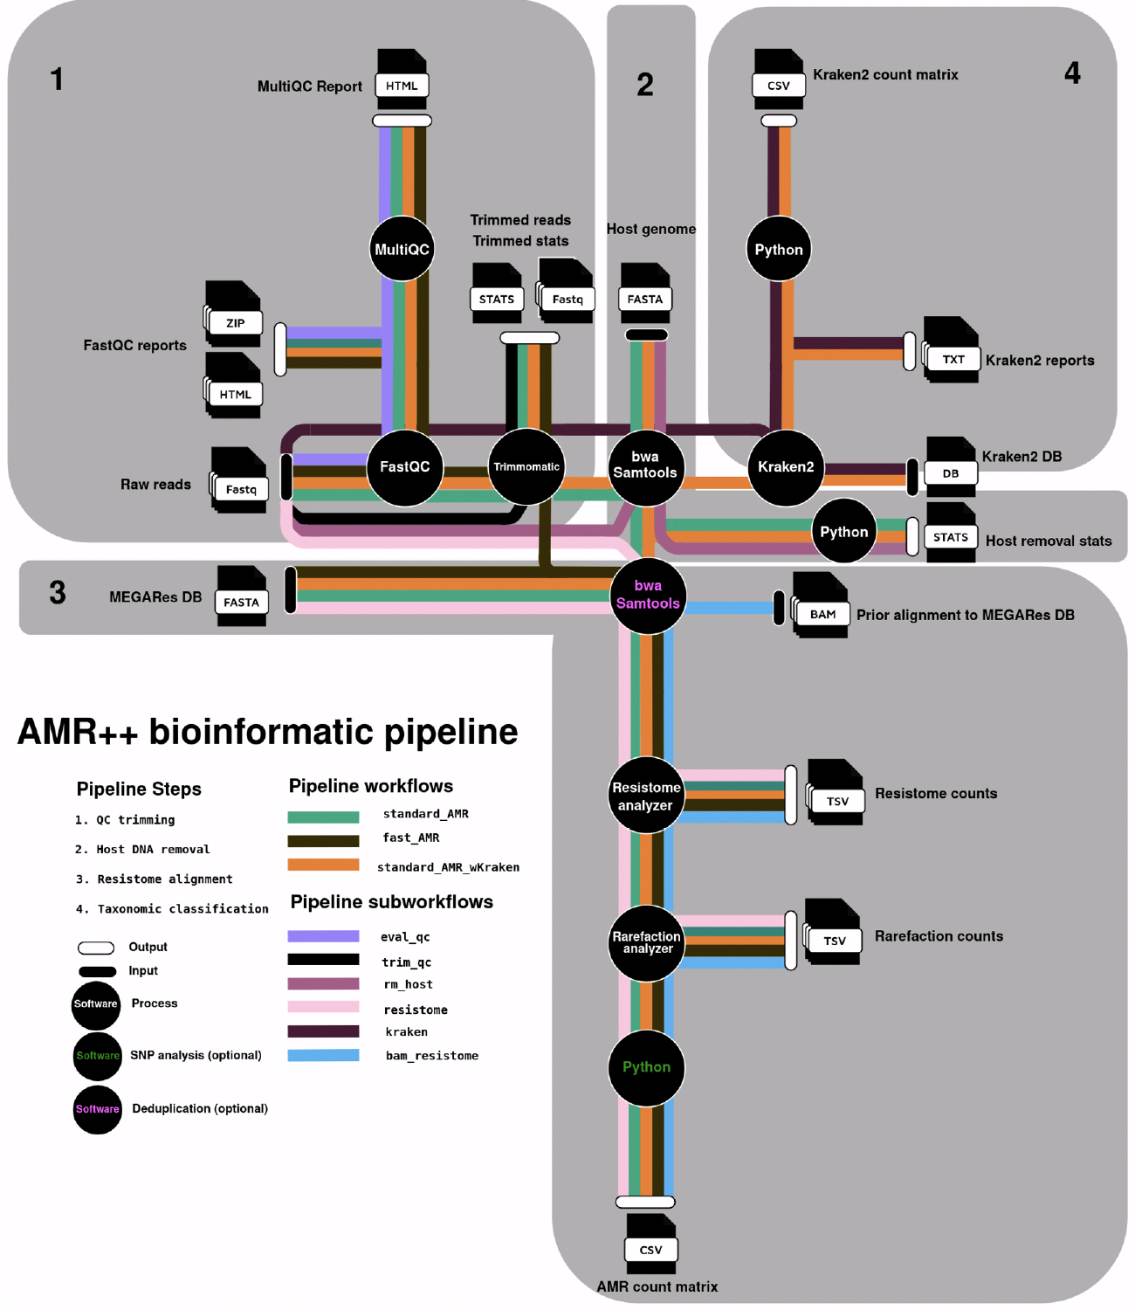

Slide 18
Learning Objectives
At the end of today, you will be able to:
Explain common sequencing errors
Interpret sequence data QC reports
Describe the characteristics of a typical metagenomic dataset
Discuss the limitations of common sequence databases
Describe and compare several bioinformatic matching algorithms
Discuss the limitations and benefits of bioinformatic matching algorithms
Execute AMR++ and understand its outputs

